Slide 1

Lifeline Hospital
& Test tube Baby Center
#122, 24th ward, Jambunath Road, HOSAPETE.
Contact No. 8867041478, 9480199611.

Slide 2
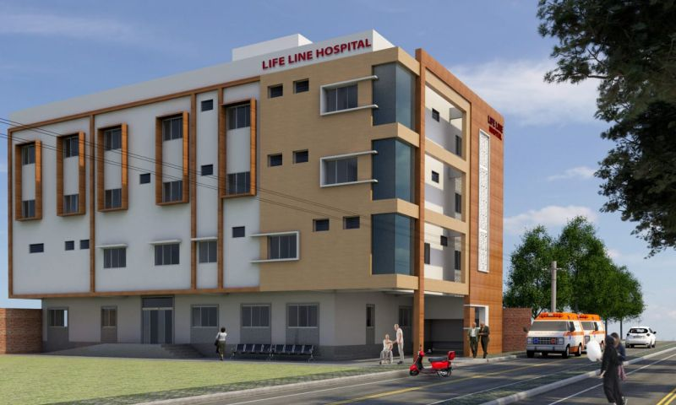
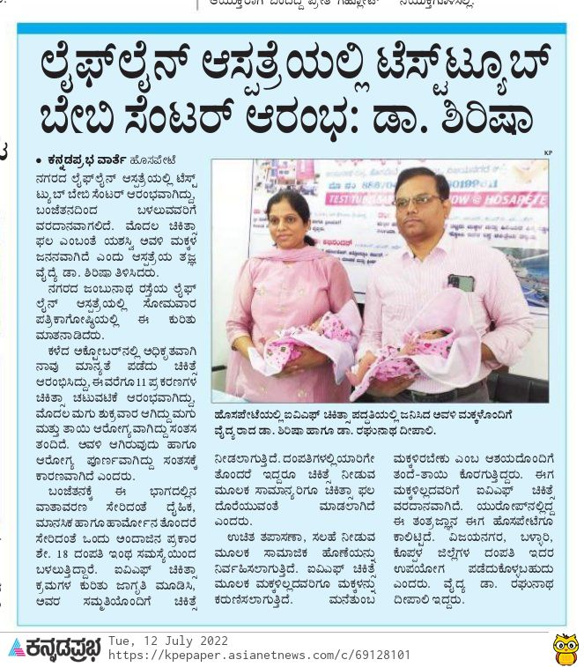
Lifeline Test tube Baby Center Team
Our Doctors
Dr. Shirish, Dr. Raghunath.

Slide 3
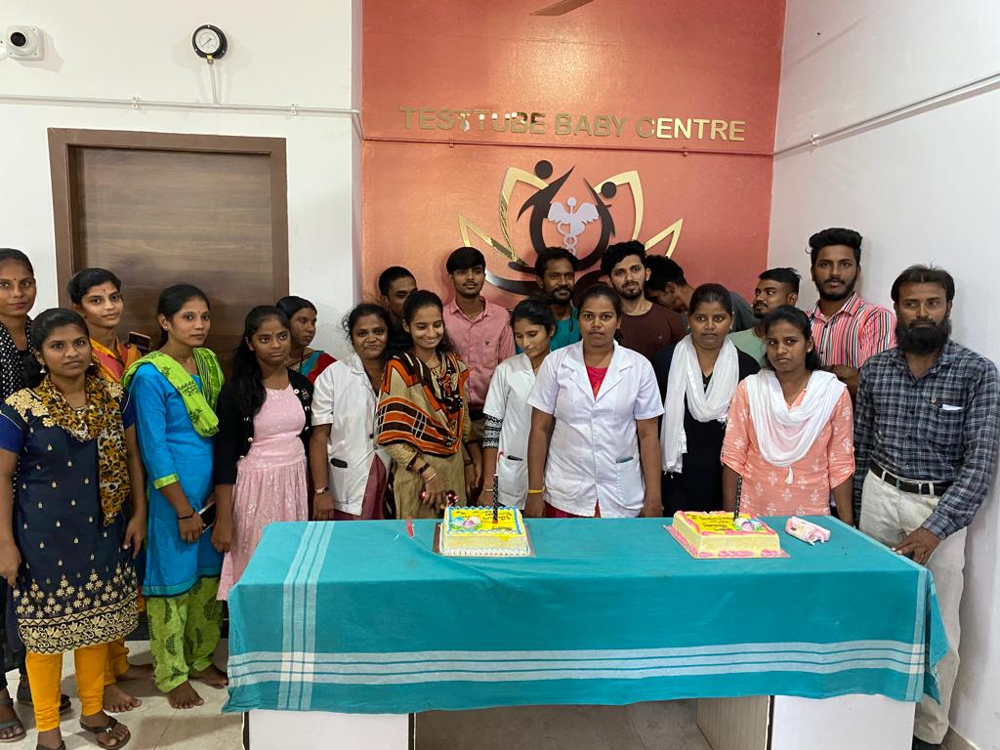
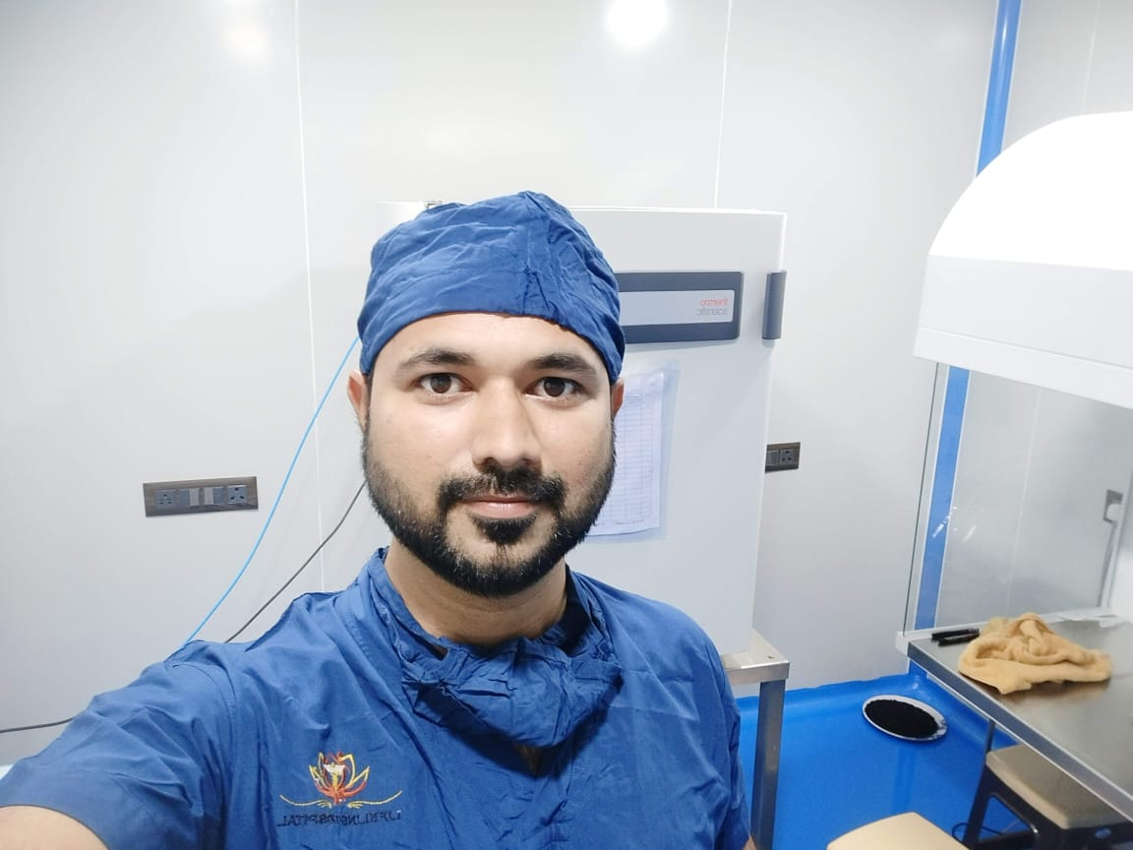
Our Team

Slide 4
Hospital Facility's
IVF
Andrology
Intra Uterine Sperm Injection (IUI)
In Vitro Fertilization Via ICSI & IMSI
PRP
Blastocyst Transfer ( To Ensure High Successes rate )
Mechanical Embryo Hatching.
Semen Analysis (Makler Chamber, Diff quick Staining).
Semen Survival Test
Semen Fructose Test
HOS Test
DFI (Sperm DNA Fragmentation Index)
Y Chromosome Microdeletion

Slide 5
High Successes Rate at Low Cost IVF
Complete Understanding of patient condition.
Ensure the best suitable way to achieve pregnancy.
Explained the Patient in his way for better understanding.
Psychological Counselling.
Blastocyst Transfer.
We try to 1st and Best transfer.
In house expert IVF Doctor, Embryologist, andrologist, counsellor, and nursing Staff.
Well equipped Lab.
Current Successes rate is > 60%

Slide 6
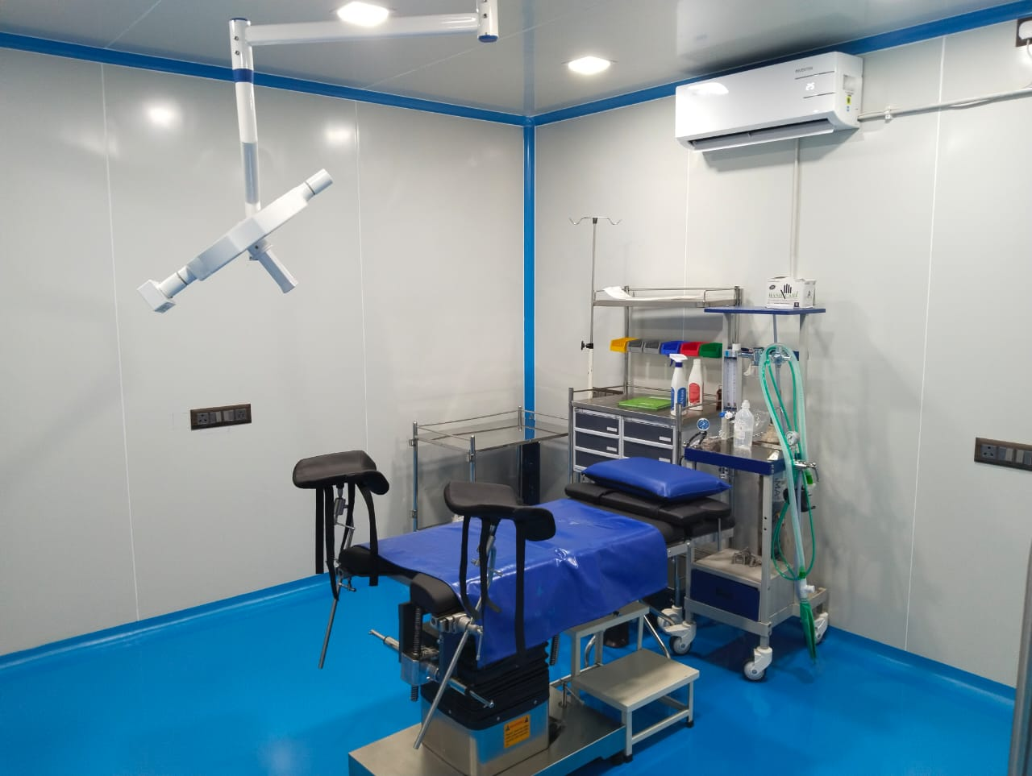
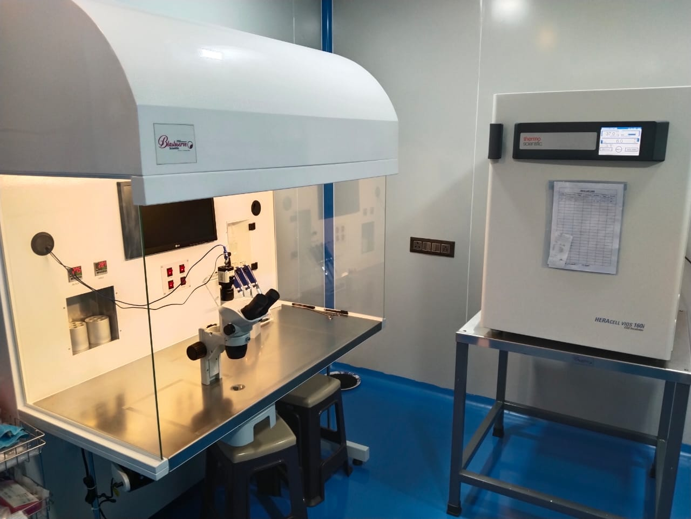
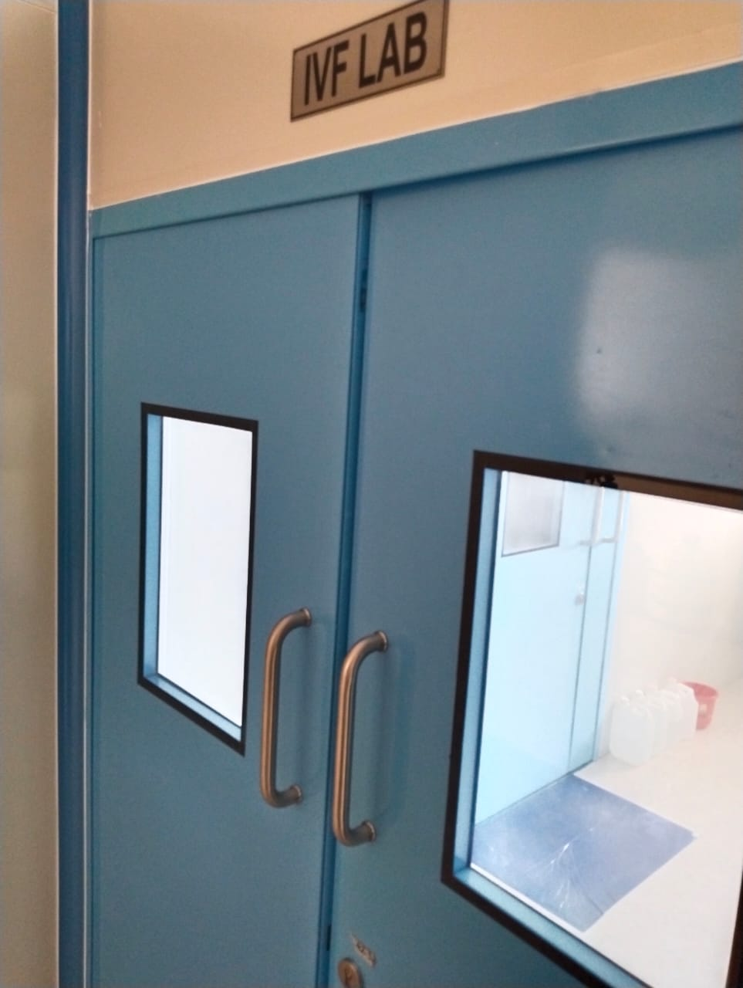
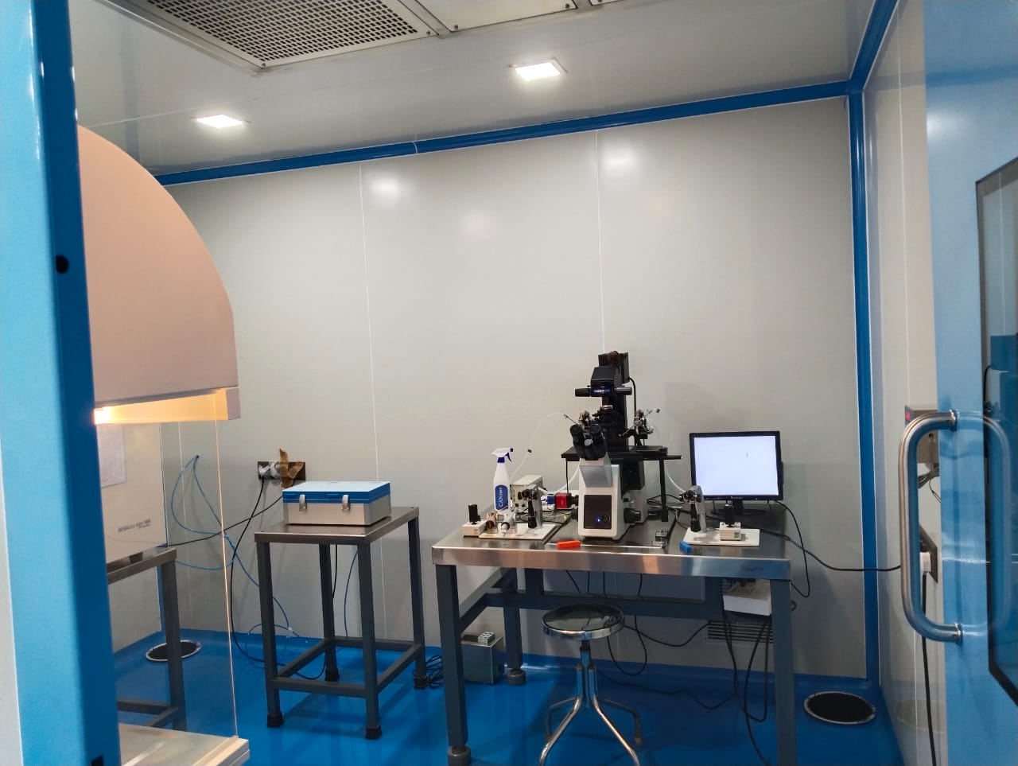
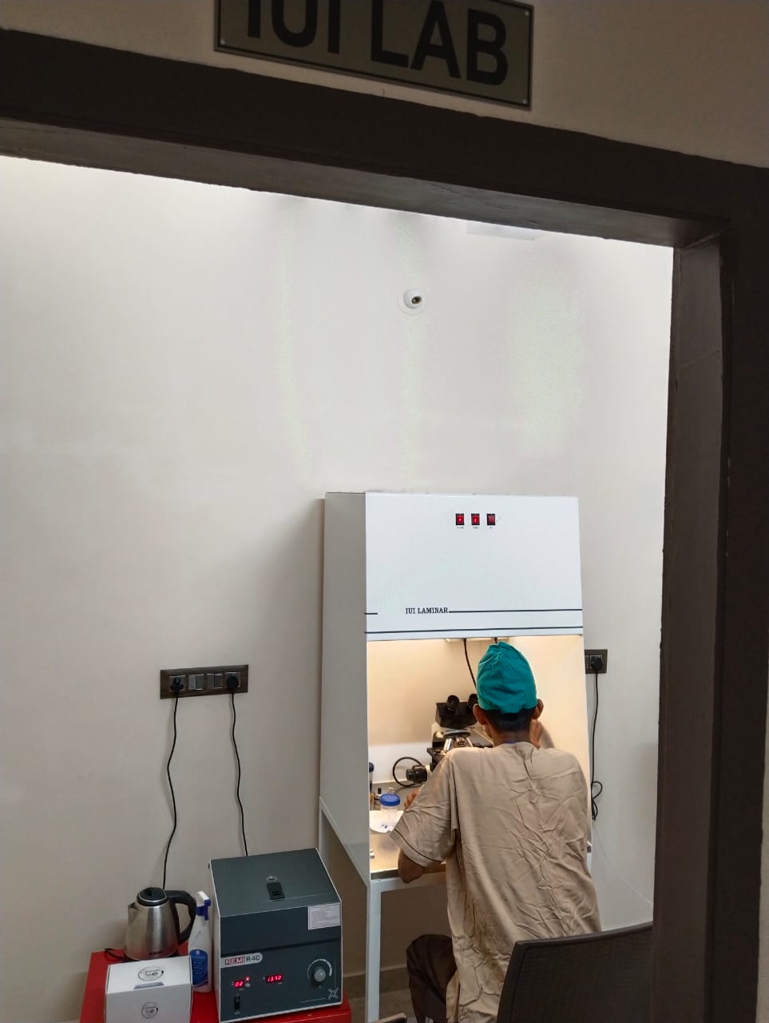
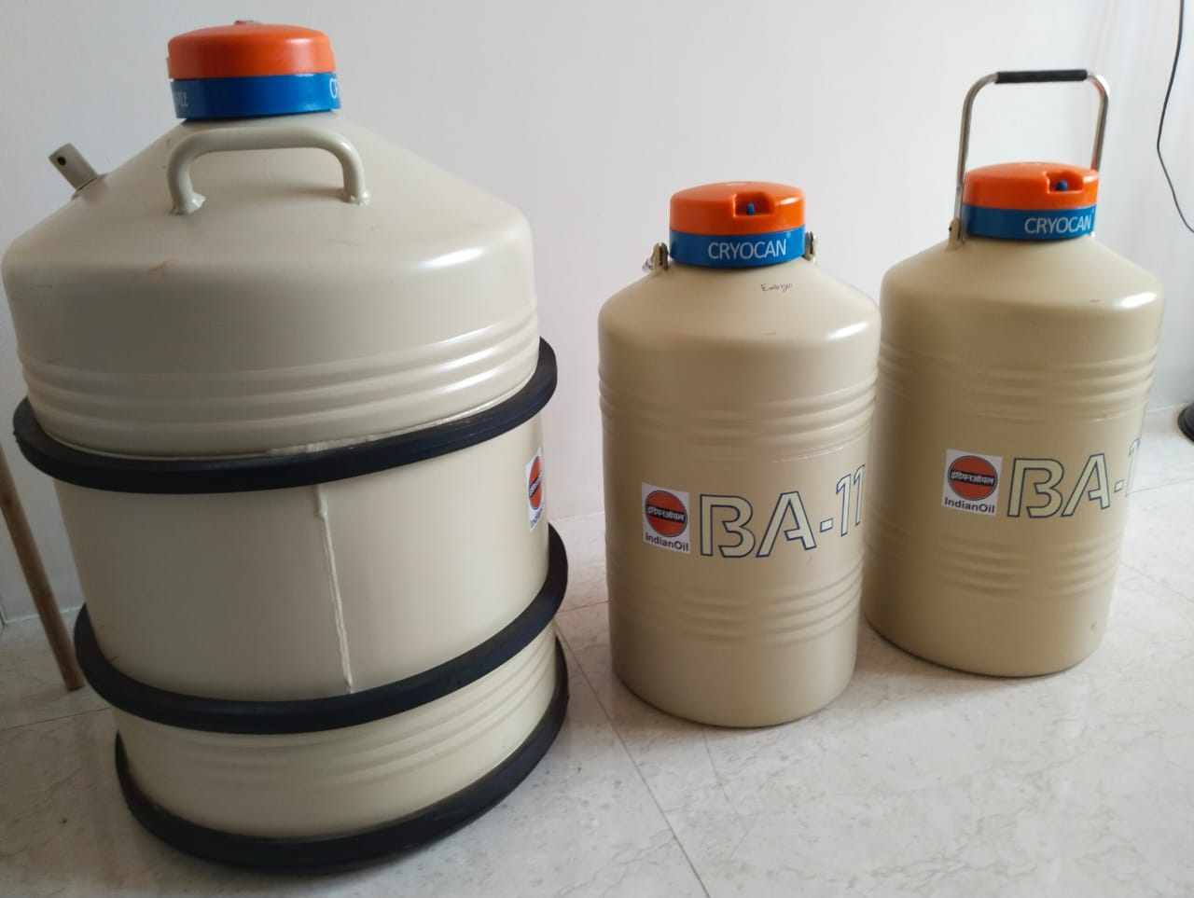
Our IVF facility

Slide 7
Training Programs For Doctor and Embryologist
Hands on Training for IUI.
Stimulation Protocol for IUI.
Semen Sample Preparation for IUI.
Complete Assistance.
Legal Guidance.

Slide 8
Thank You

